Slide 1

Cymraeg yn y cartref!
Welsh at home!
Beth am siarad Cymraeg efo dy deulu?
What about speaking some Welsh with your family?
Use the different cards to practise your Welsh and have fun!

Slide 2
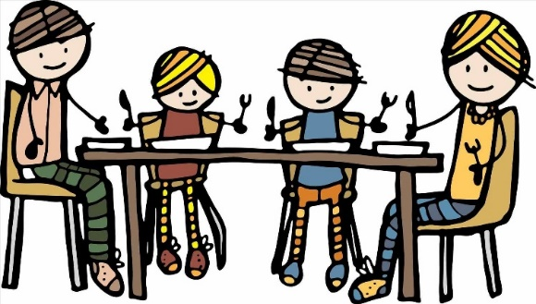

Amser bwyd – meal times
Practise your Cymraeg with a partner! Then, try to change the words that are underlined and add something different
Beth sydd i ginio, Mam?
Brechdanau bacwn a sosej
Cŵl! Ga i sôs coch hefyd?
Wrth gwrs. Wyt ti eisiau dŵr i yfed?
Dim diolch. Dw i eisiau sudd oren plîs.
O bechod! Does dim sudd ar ôl.
What’s for lunch Mum?
Bacon and sausage sandwiches
Cool! Can I have tomato sauce too?
Of course. Do you want water to drink?
No thanks. I want orange squash please.
What a shame! There’s no squash left.

Slide 3
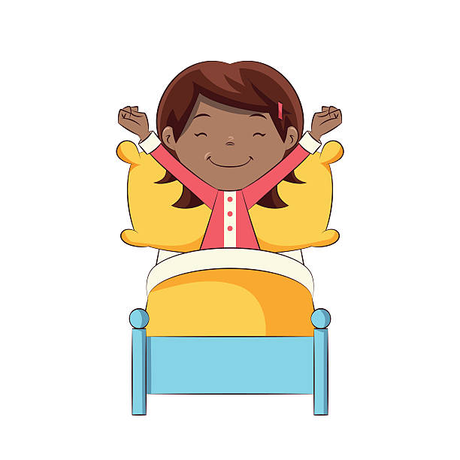
Amser deffro – time to wake up
Practise your Cymraeg with a partner! Then, try to change the words that are underlined and add something different
Bore da Ela. Amser deffro!
O na Dad! Dw i wedi blino.
Twt lol! Amser codi o’r gwely Ela!
O na Dad! Plîs ga i aros yn y gwely?
Na chei!. Dos i ‘molchi cyn brecwast.
Brecwast! Blasus iawn! Dw i’n mynd i ‘molchi.
Good morning Ela. Time to wake up
Oh no Dad! I’m tired.
Nonsense! Time to get up out of bed Ela!
Oh no Dad! Please can I stay in bed?
No you can’t. Go and have a wash before breakfast
Breakfast! Very tasty! I’m going to have a wash.

Slide 4
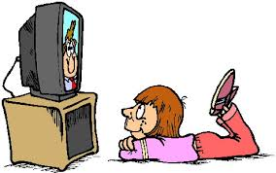
Gwylio teledu – watching television
Practise your Cymraeg with a partner! Then, try to change the words that are underlined and add something different
Ga i wylio’r teledu Mam?
Cei siŵr ond paid â gwylio sbwriel.
Iawn. Dim sbwriel. Dw i eisiau gwylio Stwnsh
Faint o’r gloch mae’r rhaglen yn dechrau?
Mae’r rhaglen yn dechrau am bump o’r gloch.
Brysia! Mae Stwnsh yn dechrau mewn dau funud.
Can I watch TV Mum?
Yes sure but don’t watch rubbish
Right. No rubbish. I want to watch Stwnsh
What time does the programme start?
The programme starts at five o’ clock.
Hurry up! Stwnsh starts in two minutes.

Slide 5

Chwarae tu allan – playing outside
Practise your Cymraeg with a partner! Then, try to change the words that are underlined and add something different
Dw i’n mynd allan i chwarae pêl-droed Mam.
Iawn ond cofia aros yn yr ardd.
Ocê. Ydy’r bêl droed yn y garej?
Ydy. Mae’r bêl yn y bocs wrth y drws. Ydy Mic y ci yn mynd efo ti?
Nefi wen! Oes rhaid i Mic ddod efo fi?
Oes. Pam? Beth sy’n bod?
Mae Mic yn rhedeg i ffwrdd efo’r bêl bob tro!
I’m going out to play football Mum
Right but remember to stay in the garden.
Ok. Is the football in the garage?
Yes. The ball is in the box by the door.Is Mic the dog going with you?
Gracious! Does Mic have to come with me?
Yes. Why? What’s the matter?
Mic runs away with the ball every time!

Slide 6

Ffonio Nain a Taid– phoning Gran and Grandad
Practise your Cymraeg with a partner! Then, try to change the words that are underlined and add something different.
Pnawn da! Tomos Jones yn siarad.
Helo Taid! Fi sydd yma. Gari!
Helo Gari. Wyt ti’n iawn?
Ydw diolch. Beth wyt ti a Nain yn wneud heddiw?
Dw i’n gwrando ar y radio ac mae Nain yn y gegin yn gwneud cacen.
O grêt! Cacen siocled i mi gobeithio!
Good afternoon. Thomas Jones speaking
Hello grandad. It’s me! Gari
Hello Gari. Are you alright?
Yes thanks. What are you and Grandma
doing today?
I’m listening to the radio and Grandma is in
the kitchen making a cake.
Oh great! A chocolate cake for me I hope!

Slide 7
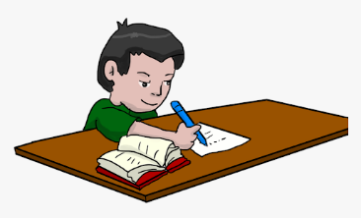
Gwneud gwaith cartref– doing homework
Practise your Cymraeg with a partner.
Ble mae dy lyfr gwaith cartref Sam?
Maen ddrwg gen i Miss Jones ond does gen i ddim gwaith cartref.
Bobol bach! Ble mae dy lyfr?
Mae fy chwaer bach wedi rhoi’r llyfr yn y bin sbwriel.
Does gen ti ddim chwaer fach.
Mae’r ci wedi bwyta’r llyfr.
Does gen ti ddim ci, dim chwaer a dim gwaith cartref.
Wps!
Where’s your homework book Sam?
Sorry Miss Jones but I haven’t got
homework
Gracious! Where is your book?
My little sister put the book in the bin.
You haven’t got a little sister.
The dog has eaten the book.
You haven’t got a dog, a sister and no
Homework
Oops!

Slide 8

Amser gwely– bedtime
Practise your Cymraeg with a partner!
Mae’n hanner awr wedi naw. Amser gwely!
O Mam! Dw i ddim wedi blino!
Mae’n amser gwely. I ffwrdd â ti!
Mae gen i boen bol!
Nag oes wir. Paid â gwneud lol.
Mae gen i ddolur gwddw!
Paid â bod yn wirion.
Mae gen i annwyd!
Amser gwely rŵan!
Its half past nine! Bedtime!
Oh Mum! I’m not tired!
It’s bedtime. Off you go!
I’ve got a stomach ache!
No you haven’t. Don’t be silly
I’ve got a sore throat!
Don’t be silly!
I’ve got a cold!
Bedtime! Now!

Slide 9
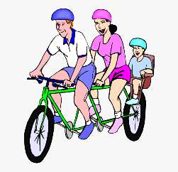
Siarad am hobïau– talking about hobbies
Practise your Cymraeg with a partner! Then, try to change the words that are underlined.
Beth wyt ti’n hoffi wneud Dad?
Dw i’n hoffi tyfu llysiau yn yr ardd achos maen nhw’n flasus. Beth amdanat ti?
Dw i’n mwynhau chwarae ar y cyfrifiadur achos mae’n gyffrous
Beth arall wyt ti’n mwynhau wneud?
Dw i’n mwynhau reidio beic efo ti a Mam achos mae’n hwyl
Pwy sy’n gallu reidio beic yn gyflym?
Fi wrth gwrs!
What do you like doing Dad?
I like growing veg in the garden because they’re tasty. What about you?
I enjoy playing games on the computer because it’s exciting
What else do you enjoy doing?
I enjoy bike riding with you and Mum because it’s fun
Who can ride a bike fast?
Me of course!

Slide 10

Cadw’n heini – keeping fit
Practise your Cymraeg with a partner!
Mae’n amser cadw’n heini efo Joe Wicks. Wyt ti’n barod?
Nag ydw. Mae’n well gen i eistedd ar y soffa.
Paid â bod yn wirion. Dos i nôl dy dreinyrs.
Mae’n bwysig cadw’n heini.
Dw i’n barod. Dw i’n gwisgo crys t, siorts a treinyrs.
Gwych! Deg naid seren! I ffwrdd â ni!
Nefi wen! Dw i wedi blino yn barod.
It’s time to keep fit with Joe Wicks. Are you ready?
No. I prefer to sit on the sofa
Don’t be silly. Go and fetch your trainers. It’s important to keep fit.
I’m ready. I’m wearing a t shirt, shorts and trainers
Super! Ten star jumps! Off we go!
Gracious me! I’m tired already.

